Slide 1


Innovating with IoT

Slide 2



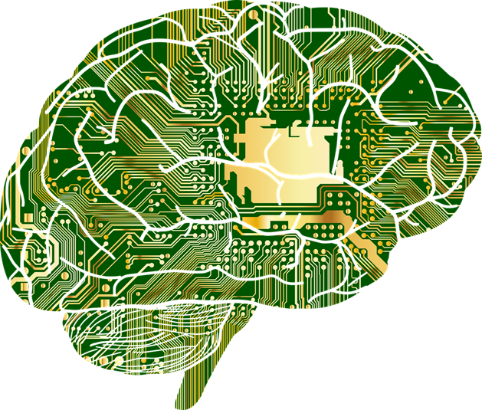
AGENDA
01
OVERVIEW
02
CONFIGURATION
03
LIVE DEMO

Slide 3
01 OVERVIEW

Slide 4

WHAT IS IoT ?
Universe of Devices with Internet Connectivity

Slide 5
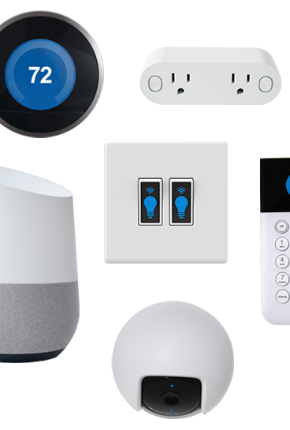
THINGS
Any device, embedded device which has a sensor or similar application and an internet connectivity which can read or publish the data to the cloud or to the server

Slide 6
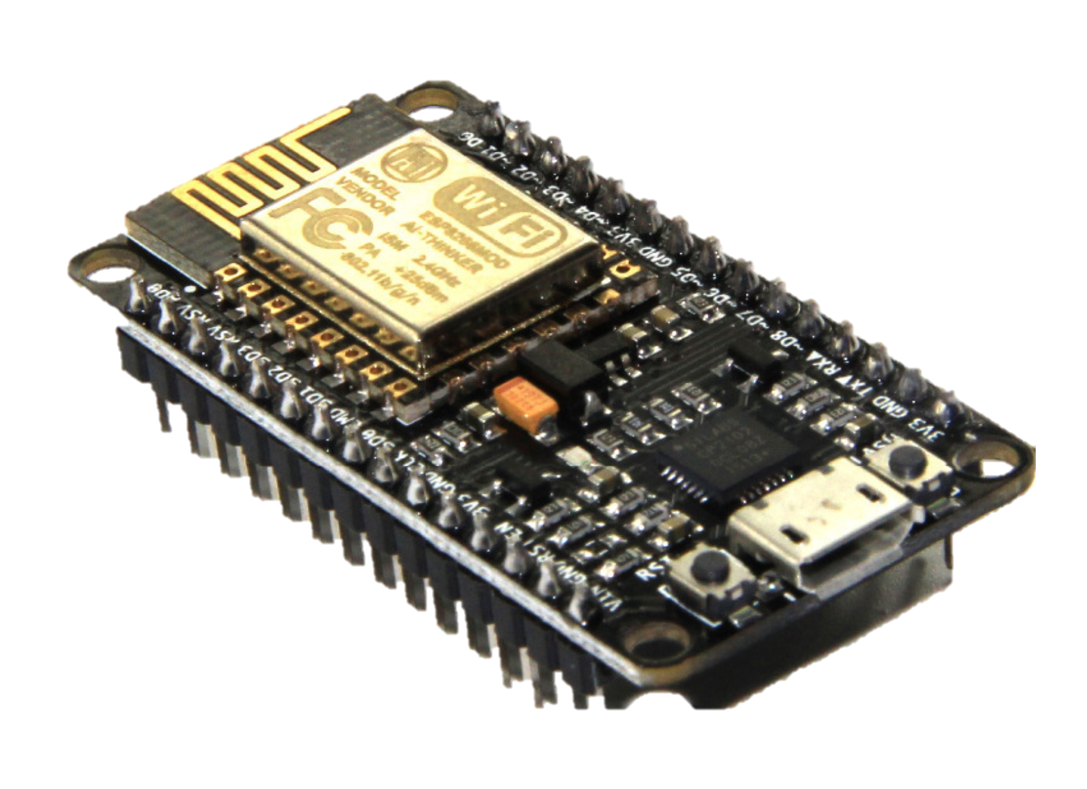
NODEMCU
Low Cost
Easy to Program
IoT Enabled
Low Power Consumption

Slide 7
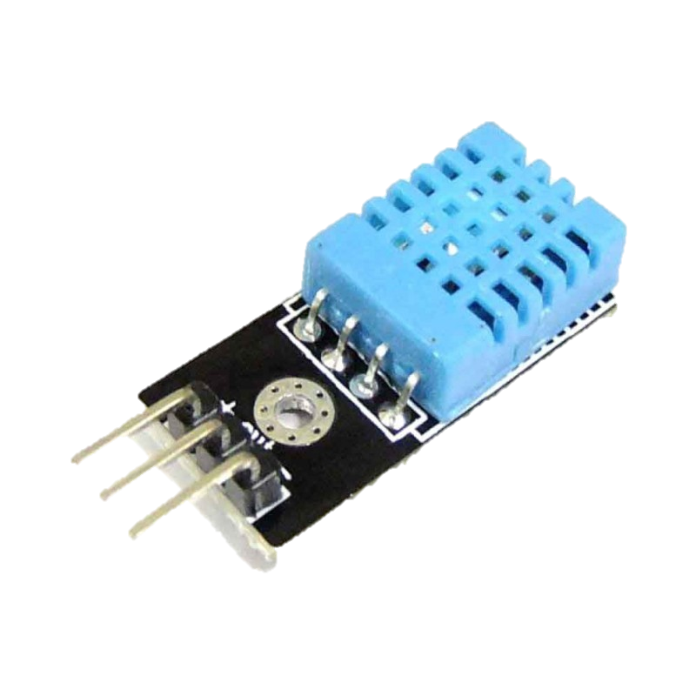
DHT11
Temperature and Humidity
Libraries Available
Digital Sensor
Simple to Interface

Slide 8

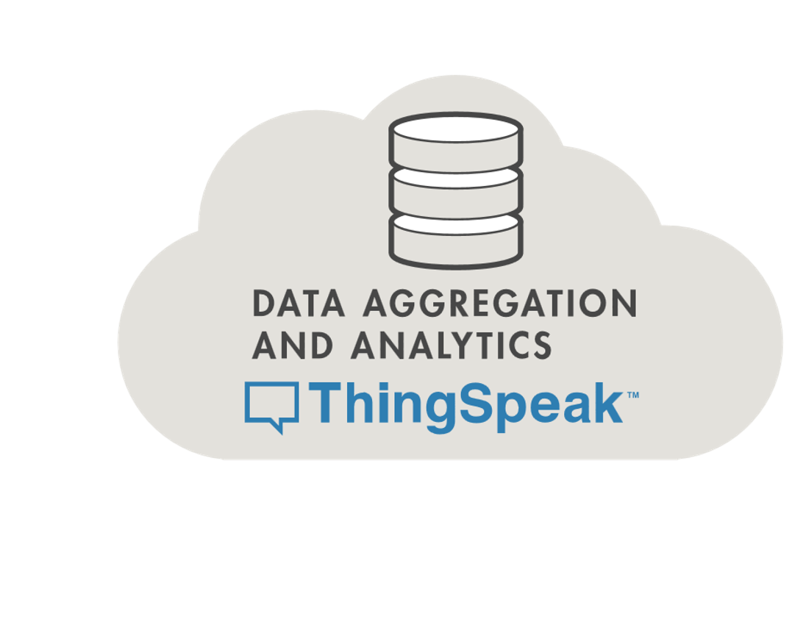
Powered by MATLAB
Fast and Instant
Data Analytics
MQTT

Slide 9
02 CONFIGURATION

Slide 10
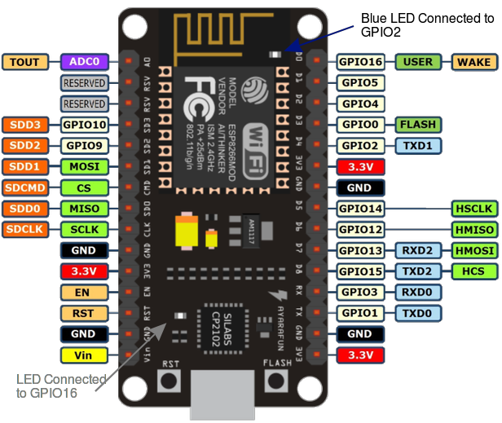
NODEMCU PIN DIAGRAM

Slide 11
PIN CONFIGURATION
Pin | Code | Arduino alias | Pin | Code | Arduino alias
A0 | A0 | A0 | D6 | GPIO 12 | 12
D0 | GPIO 16 | 16 | D7 | GPIO 13 | 13
D1 | GPIO 5 | 5 | D8 | GPIO 15 | 15
D2 | GPIO 4 | 4 | SD2 | GPIO 9 | 9
D3 | GPIO 0 | 0 | SD3 | GPIO 10 | 10
D4 | GPIO 2 | 2 | RX | GPIO 3 | 3
D5 | GPIO 14 | 14 | TX | GPIO 1 | 1

Slide 12
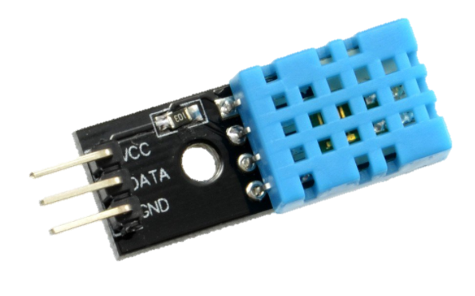
DHT11 PIN DIAGRAM

Slide 13
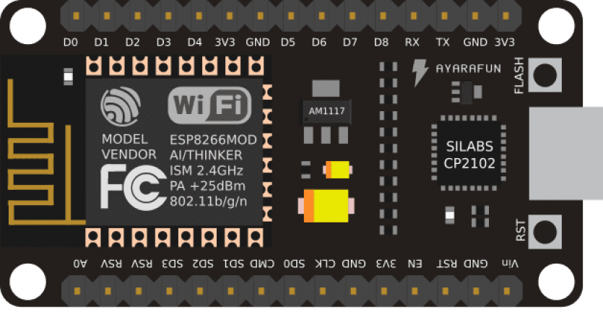
CONNECTIONS

Slide 14
03 LIVE DEMO

Slide 15


CONNECT WITH ME
GOKUL KRISHNAN S
https://linkedin.com/in/gokulkkr

Slide 16




ISTE.VIT
ISTE_VIT_VELLORE
INDIAN SOCIETY FOR TECHNICAL EDUCATION
ISTE-VIT
Thank You!

